Slide 1
5-HT_{2A}-mGlu₂ heterodimers & their implications for the behavioral effects of serotonergic psychedelics
Kevin Krupp

Slide 2
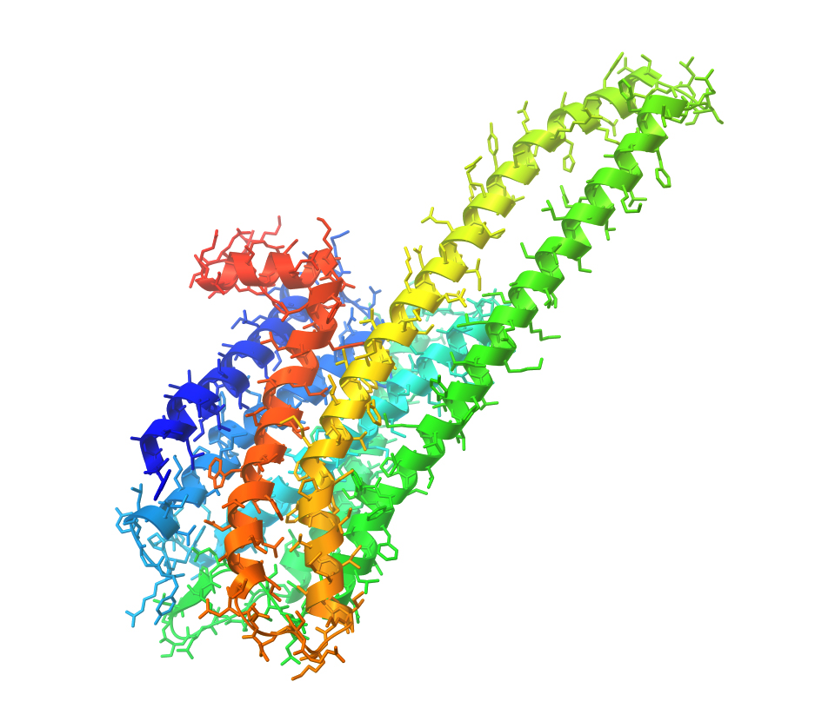
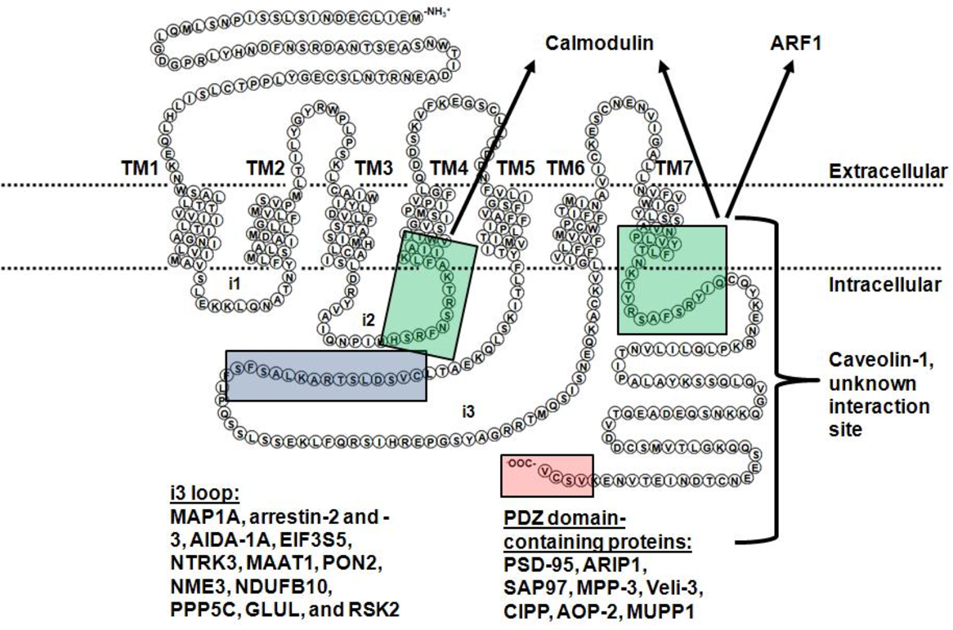
Serotonin-2A Receptor (5-HT_{2A})

Slide 3
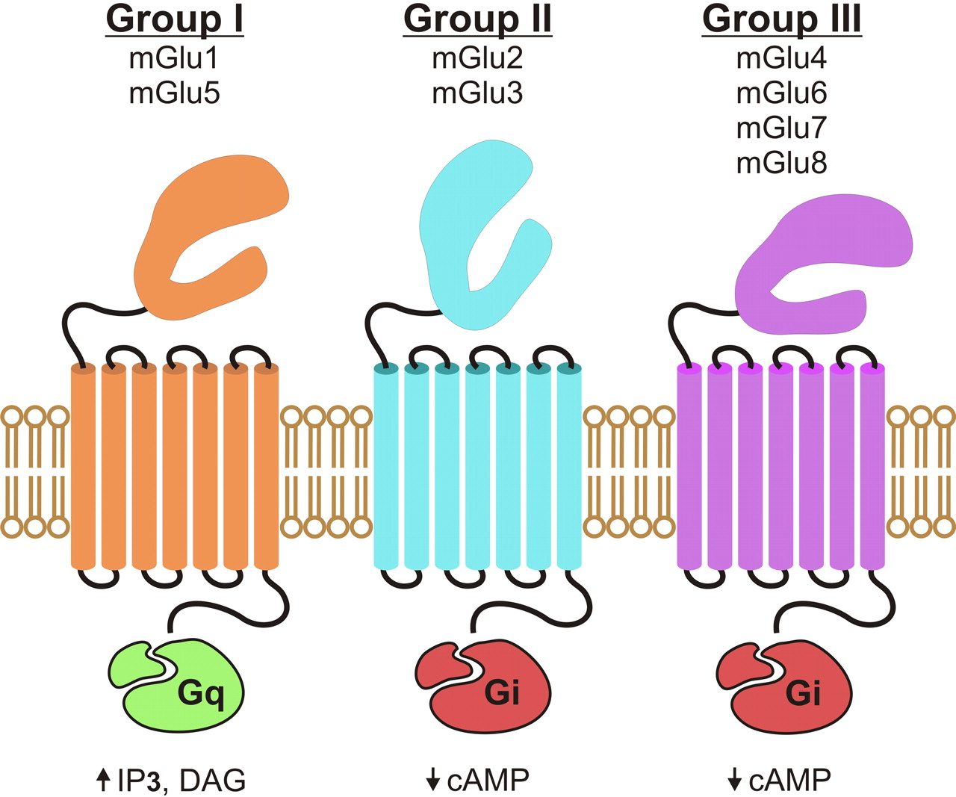
Metabotropic Glutamate II Receptor (mGlu₂₎

Slide 4
5-HT_{2A}
Generally/classically thought of as a post-synaptic receptor
mGlu₂
Generally/classically thought of as a pre-synaptic receptor

Slide 5
Identification of a Novel Serotonin/Glutamate Receptor Complex Implicated in Psychosis
Postmortem prefrontal cortex from young untreated schizophrenic subjects
5-HT_{2A}↑
mGlu₂ ↓
a pattern that could predispose to psychosis (González-Maeso et al., 2008).
Maternal Influenza Viral Infection Causes Schizophrenia- Like Alterations of 5-HT2A and mGlu2 Receptors in the Adult Offspring
In frontal cortex of mice born to influenza virus-infected mothers, the 5-HT2A receptor is upregulated and the mGlu2 receptor is downregulated, an alteration that may be involved in the behavioral changes observed. (Morena et al 2011)

Slide 6
Autoradiography in rats - expression of 5-HT_{2A} and mGlu_{2/3}
³H-LY354740
¹²⁵I-DOI
Similar distribution in mPFC but not frontoparietal cortex
(Marek et al. 1999)

Slide 7
mPFC + 5-HT_{2A}
Dorsal Raphe
= 5-HT_{2A}
I
II /III
IV
V
VI
Serotonin
=AMPA+NMDA
Mediodorsal +
Midline/intralaminar
thalamus
Glutamate
= mGlu₂
EPSP from 5-HT_{2A} on apical dendrites
(Blocked by 5-HT_{2A} antagonist+ removal of apical dendrites)
But…
EPSP suppressed w/ mGlu_{2/3} agonist LY354750
Midline/intralaminar lesions
- Suppress 5-HT EPSPs (~61-67%)
- Reduce mGlu₂ expression
5-HT_{2A} also localized on
Layer II/III Projection neurons (Glu)
Parvalbumin interneurons (GABA)
Somatostatin interneurons (GABA)
Microglia
Astrocytes
Glu
+ TTX
+ AMPA antagonist
+ µ-opioid agonist
+ mGlu₂ PAM
Cortex
Amygdala
PAG
Brain stem
Spinal Cord
Notes:
Electrophysiology experiments from rodent brain slices

Slide 8
Serotonergic Psychedelics
Potential Risks / Limitations
Placebo
”bad trips”
Risk severely minimized in clinical setting (pre-screenings, training)
Hallucinogenic Persisting Perception Disorder
Therapeutic potential in humans treating
Anxiety/PTSD
Depression (treatment resistant)
Rapid & long-lasting relief ( up to 6 months)
Substance Abuse
alcohol, nicotine, opioids (ibogaine?)
Obsessive Compulsive Disorder
Low potential for abuse
not reinforcing + rapid tolerance
Significant downregulation of 5-HT_{2A} w/ chronic treatment of DOI/LSD
(Carhart-Harris & Goodman 2017, Dos Santos et al 2016)
Exert psychoactive effects through 5-HT_{2A}
Functional selectivity
Pretreatment w/ 5-HT_{2A} antagonist blocks primary effects in humans (Kometer & Vollenweider 2018)
Psychoactive substances, lead to altered states of consciousness that impact
Sensory processing (hallucinations, synesthesia)
Mood
Other cognitive processes
Effects resemble core symptomologies of schizophrenia
(Kyzar et al. 2017)

Slide 9
Head Twitch Response (HTR)
(Halberstadt & Meyer 2013)
Induced by serotonergic psychedelics
Not non-psychedelic 5-HT_{2A} agonists (Lisuride)
Absent in 5-HT_{2A}^{-/-} KO mice
Restored by selective restoration in cortical pyramidal cells
Infusion of DOI into the prelimbic cortex sufficient (Willins & Meltzer 1997)
But… HTR also reported to be induced by
5HTP
SR141716A (CB₁ antagonist)
Yohimbine (alpha-2 antagonist) (reported to cause hallucinations)
Atropine (muscarinic antagonist)
mGlu2/3 agonist LY354740 blocks HTR
mGlu2 KO block HTR but not mGlu3 KO
Restoring mGlu2 expression in frontal cortex neurons restores HTR
Not restoration of mGlu2ΔTM4N
mGlu2 KO mice do not show HTR (LSD or DOI)
Canal & Morgan 2012

Slide 10
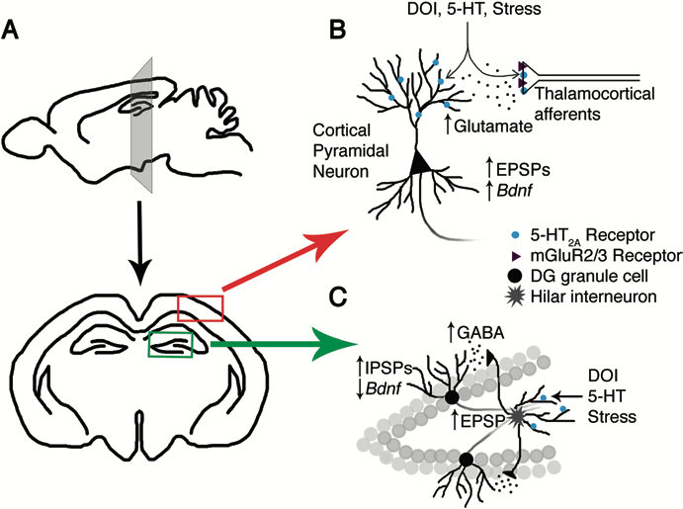
Serotonergic Psychedelics and 5-HT_{2A} signaling
Ser²⁸⁰ phosphorylation
(il-3)
Transcriptomic signature of hallucinogens in rodent frontal cortex
+c-fos
G_{q} dependent
+egr-1 & egr-2
G_{i/o} dependent
(Gewirtz et al. 2002)
DOI (5mg/kg)
↑ BDNF mRNA in mPFC
mGlu₂ agonist (LY35470)
dose dependently blocked upregulated BDNF in mPFC, other cortical regions, claustrum
But not midline/intralaminar thalamus
LY341495 (mGlu₂ antagonist)
enhances DOI induced BDNF upregulation in the mPFC

Slide 11
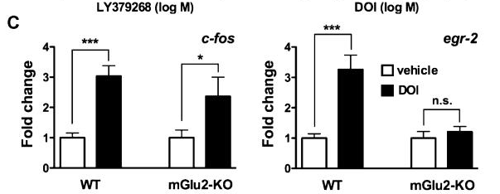
Frontal Cortex of C57/Blk6 mice treated w/ DOI
mGlu2 KO dampens c-fos
mGlu2 KO completely blocks egr-2
expression
(C) Cellular response in mouse frontal cortex assayed by qRT-PCR. Wild type or mGluR2-KO mice were injected with vehicle (white) or DOI (black; 2mg/kg). Changes in expression levels are reported as fold change over vehicle.

Slide 12
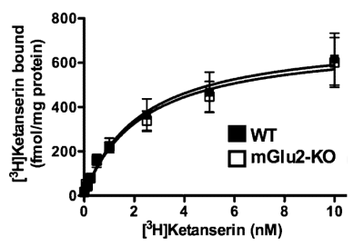
mGluR2 knock out does not impact the expression of 5-HT2A in the frontal cortex of C57/Blk6
(Moreno et al 2011)

Slide 13
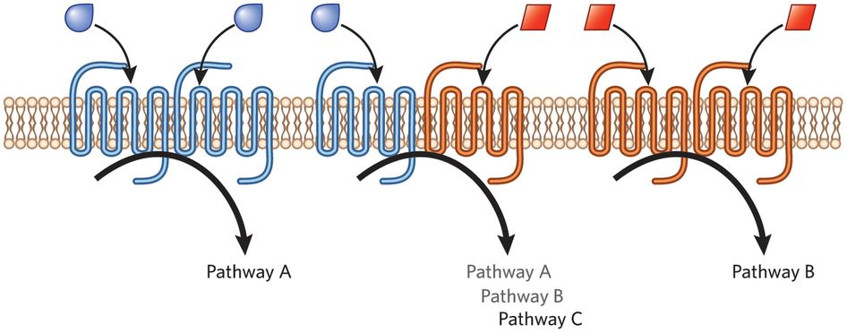
G Protein Coupled Receptor (GPCR) oligomers
GPCRs long thought to exist as monomers
Now known GPCRs can exist as oligomers
Including homodimers, heterodimers, trimers, tetramers
Covalent bonds / intermolecular forces between transmembrane loops connect (protomers)
Allosteric modulation of function
Can alter
G protein coupling, signaling, sensitization, endocytosis

Slide 14
Evidence for 5-HT_{2A} heterodimer in vitro
In vitro cell studies
Receptors are in close proximity when co-expressed and influence the signaling of both receptors
Uncertain if this occurs in vivo

Slide 15
Evidence for 5-HT_{2A}-mGlu₂ heterodimer in layer V cortical neurons in vivo
LY379 = mGlu_{2/3} agonist
Prevents LSD ↑ in egr-2
Co-labelling in mouse somatosensory cortex
Layer V neurons at the soma
(González-Maeso et al 2008)
Notes:
Double-label FISH was performed in SCx layers V and VI in mice injected (i.p.) with vehicle or 0.24 mg/kg LSD 15 min after beingpre-injected with vehicle or 15 mg/kg LY379

Slide 16
Evidence for 5-HT_{2A}-mGlu₂ heterodimer in layer V cortical neurons in vivo
Co-expression of endogenous
5-HT_{2A} and mGlu2
in frontal cortex &
primary cortical cultures
(Fribourg et al 2011)

Slide 17
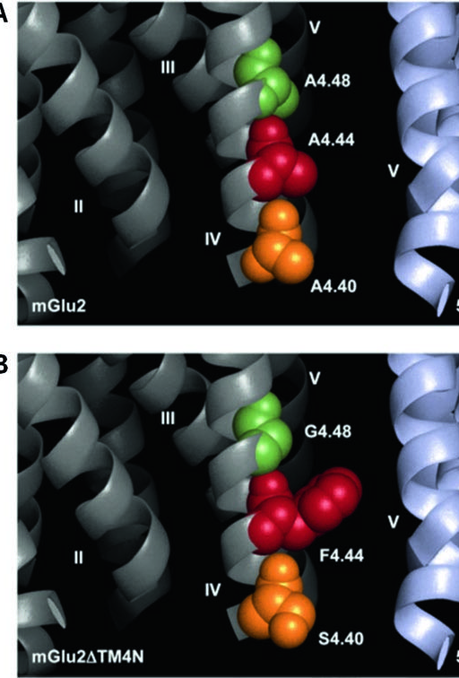
Any two of the three residues at the intracellular end of TM4
responsible for the difference in GPCR heteromeric formation between the 5-HT2A and mGlu2
But a lot of evidence suggests role for pre-synaptic mechanism of 5-HT_{2A}
These techniques don’t provide the visual acuity needed to visualize these receptors in presynaptic terminals

Slide 18
Advantages Immunogold Labelling
Gold nanoparticles
Electron microscopy
Bind to primary antibody attached to target of interest
Gold is used for its high electron density
↑ electron scatter to give high contrast 'dark spots’
Optimize protein localization at subcellular compartments and membrane microdomains
Fluorescent tags give off a lot of “noise”
Hard to determine precise location of protein

Slide 19
Gold nanoparticle localization of 5-HT_{2A} & mGlu₂ in mouse frontal cortex
5-HT_{2A}
larger 10-nm gold particles
mGlu₂
smaller 6-nm gold particles
Co-localization of 5-HT_{2A} & mGlu₂

Slide 20
ACC
Synaptosome
Pre-synapse
PrL
Post-synapse
IL
5-HT_{2A}
Synaptophysin
5-HT_{2A} is expressed in presynaptic and
post-synaptic terminals of the mPFC
Munc 18
PSD-95
GluN1
GluN2B

Slide 21
DOI enhanced NMDA mediated EPSCs
Blocked w/ pre-application of Ketanserin
Paired-pulse ratio
DOI ↑ NMDA EPSC
Increase in neurotransmitter release
from presynaptic terminals
Blocked in 5-HT_{2A} KO
DOI did not influence NMDA mediated EPSCs
with selective engagement of post-synaptic NMDA
Presynaptic mechanism?
Notes:
NPC15437 = PKC inhibitor
U73122 = PLC inhibitor
On slides blocked DOI enhanced NMDA potentiation
GDP-βS (G protein signaling inhibitor) or U73122 into the recodring pipette did NOT block NMDA potentiation by DOI
NPC15437 or BAPTA (binds Ca⁺⁺) into the pipette tip
Transient potentiation of of NMDA currents that returned to baseline after 15-20 min

Slide 22
Stimulating electrodes in Layer I
Recording EPSCs in Layer V neurons
Only selective restoration of 5-HT_{2A} in the MD thalamus restores DOI evoked NMDA EPSC

Slide 23
PKC and calcium-dependent signaling elicited by presynaptic 5-HT2A receptor activation trigger early phase of NMDA potentiation
Maintenance might involve PKC and calcium- dependent signaling induced by postsynaptic 5- 5-HT_{2A}
PKC can potentiate GluN2B subunit containing NMDA function
(phosphorylation of either Ser^{1303/ 1323} each potentiates NDMA currents)

Slide 24
Notes:
Novel-object recognition task. During the training phase, animals were allowed to explore two different objects for 5 min and placed in their home cage for 1 h, during which time the arena and objects were cleaned. Animals were then placed back into the arena in presence of an identical copy of one of the familiar objects and a novel object and allowed to explore the objects freely for 5 min. At the end of this recognition phase, animals were removed and returned to their home cage.
Object-location task. During the training phase, animals were allowed to explore two different objects for 5 min and placed in their home cage for 1 h. After this delay, the animals were placed back into the arena containing the objects present in the training sample phase. One of them was placed in the location previously occupied during the training phase, while the other one was placed in a new location within the arena. Object exploration was recorded for 5 min and animals were removed and returned to their home cage.
Object-in-place task. During the training session, animals were allowed to explore for 5 min four different objects placed in the four corners of the arena. The animals were removed from the arena for the delay period (1 h) and placed back in the arena that contains the same objects and where the positions of two objects were exchanged. Object exploration was recorded for 5 min.

Slide 25
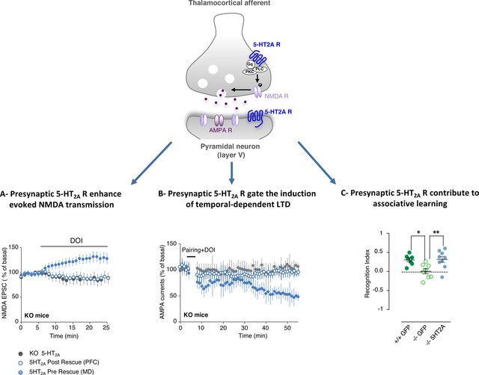
Bećamel et al 2017

Slide 26
So far….
5-HT_{2A}-mGlu₂ heterodimers occur in vivo
Post-synaptic localization on layer V projection neurons
Pre-synaptic localization on thalamocortical afferents
Possible targets of serotonergic psychedelics (Martin & Nichols 2016)
Implications for therapeutic effects of psychedelics??
Implications in schizophrenia
“Balance” of signals may predispose to psychotic states + hallucinations

Slide 27
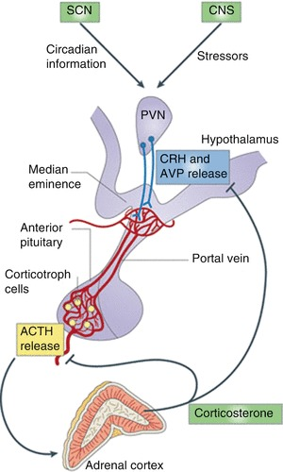
Stress
Adaptive
HPA axis activation & stress hormones
Chronic stress → Depression
Symptoms – Anhedonia, Despair, Suicide
Inadequate Treatments – 1 in 3 find relief
But…

Slide 28
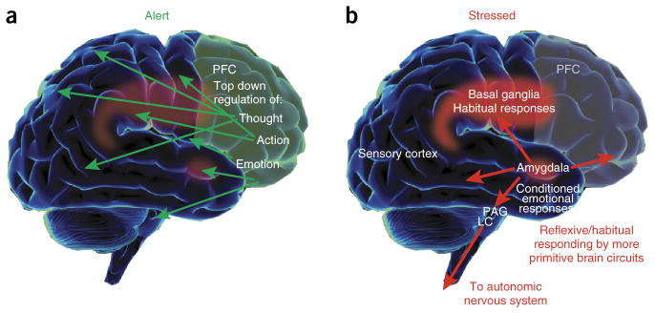
(Arnsten 2015)
Notes:
(a) Under conditions when a subject feels alert, safe and interested, phasic release of catecholamines strengthens the higher cognitive functioning of the PFC, thus allowing top-down regulation of thought, action and emotion. In primates, the PFC is topographically organized, with the dorsal and lateral surfaces mediating attention, thought and action while the ventral and medial aspects mediate emotion. The anatomical projections of these areas reflect these specializations. (b) During stress exposure, high levels of catecholamines take the PFC ‘off-line’ while strengthening the functions of more primitive circuits—for example, the conditioned emotional responses of the amygdala and the habitual actions of the basal ganglia. The amygdala activates brainstem stress systems, which in turn activate the sympathetic nervous system.

Slide 29
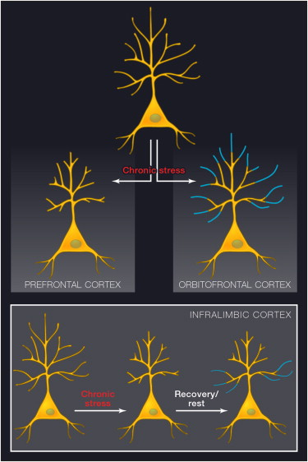
mPFC is compromised in depression
Effect of antidepressants
McEwen & Morrison 2013

Slide 30
Dendrite + spine growth from serotonergic psychedelics
Effects blocked by pretreatment with
1. 5-HT_{2A} antagonist
2. TrkB antagonist
3. mTOR inhibitor
PMID: 28161375, 29898390

Slide 31
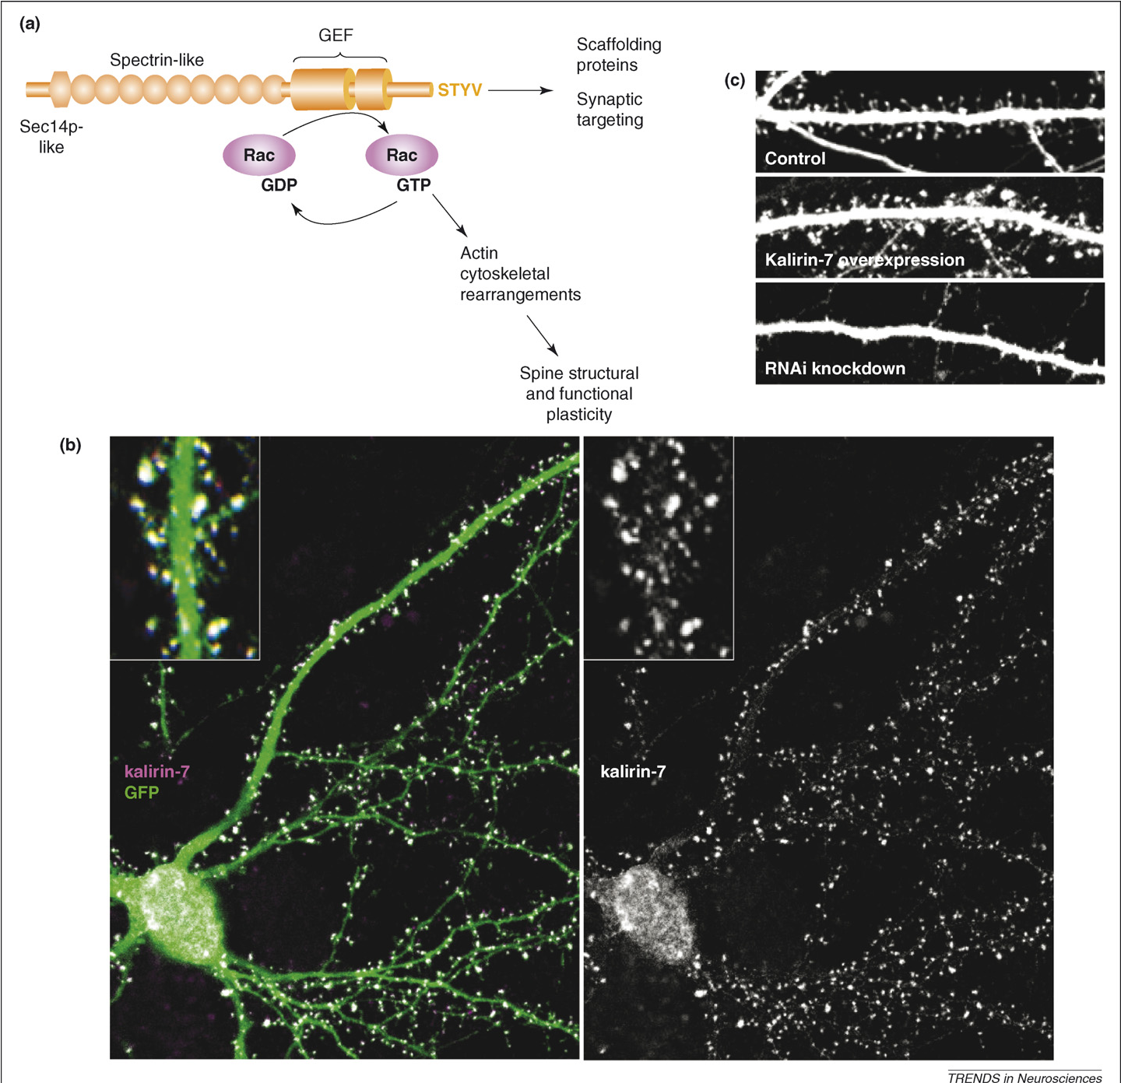
Kalirin-7
Pos-synaptic protein involved in spine morphogenesis
DOI enhances spine growth in cultured cortical neurons via kalirin-7 pathway
Enhances f-actin growth
Dendritic spine dynamics – a key role for kalirin-7
(Jones et al. 2009)

Slide 32
5-HT_{2A} immunoreactivity in Prelimbic cortex (layer V)
Blue: DOI-PV(+)
Red: Con-PV(+)
Control
DOI
5-HT_{2A} internalization
DOI 5 mg/kg
~ 12% of PV interneurons in the PFC co-stain for c-Fos
Only 1.4% under control conditions (Abi-Saab et al. 1999)
↑ in extracellular GABA following local PFC infusion of DOI also occurs
PV interneuron c-fos
(Martin & Nichols 2016)

Slide 33
DOI directly activated excitatory neuronal cell populations express higher levels of:
5-HT_{2A} mRNA in mPFC
5-HT_{2A} and mGlu₂ in SSC
(Martin & Nichols 2016)

Slide 34
mloCal-XRs – passive visualization of receptor trafficking and intracellular Ca⁺⁺ signals in receptor specific microdomains
Membrane localized Ca⁺⁺ sensing domain
Spectrally shifted fluorescent tag
Receptor trafficking signal (c-terminus)
CaMello-XRs - allow for additional optogenetic control of G_{q/11} signals.
Engineered in a comparable manner
Built around a light-activated GPCR as a backbone
CaMello-XR and mloCal-XR optogenetically control and monitor the intracellular Ca²⁺ changes directly in the GPCR microdomain and relate the Ca²⁺ signal to the trafficking of the GPCR

Slide 35
HEK cells
TCB-2 promotes 5-HT_{2A} internalization and high colocalization with Rab7 endosomes (target for degradation)
Low light stim or 5-HT application
lower Rab7 colocalization

Slide 36
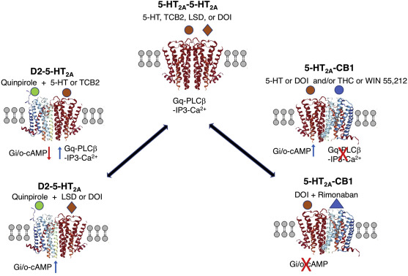
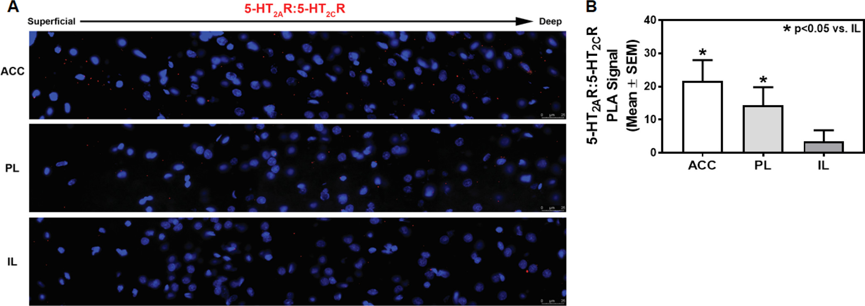
5-HT_{2A} is promiscuous
Evidence for heterodimers with
5-HT_{2C}
Dopamine 2 receptors
CB1 receptors
Chronic THC*

Slide 37
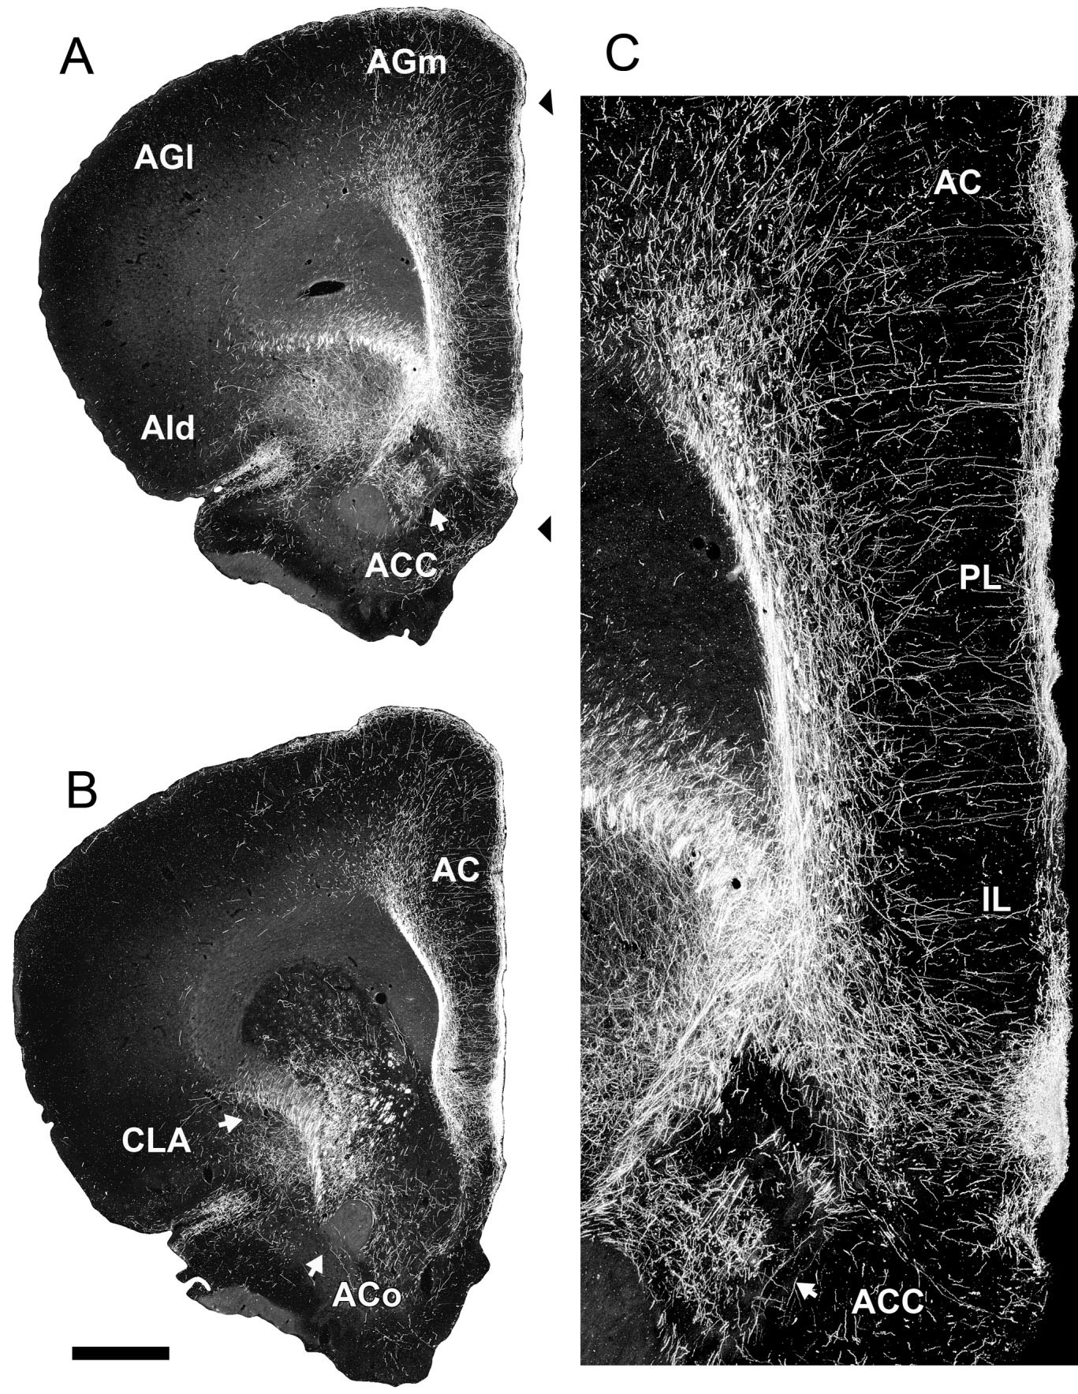
Circuit for head-twitch response?
Jankowski et al 2014
Nucleus reuniens neurons control head directionality
Maybe head-twitches are induced by increased nucleus reuniens thalamic inputs terminating on layers I and V of the mPFC, which, when activated can target the basal ganglia
Also involved in learning fear + fear extinction
Efferent Projections of Reuniens and Rhomboid Nuclei of the Thalamus in the Rat

Slide 38
Involvement of the Claustrum
Very high 5-HT_{2A} expression
Neurons continually fire w/ admin of serotonergic psychedelics
Increase GABA in mPFC?
Different distribution of afferents between ACC/ Prelimbic / Infralimbic

Slide 39
Conclusion?
Localized on thalamocortical axon terminals:
↑ Glu release through enhanced G_{q} signaling and NMDA potentiation
mGlu₂ cannot efficiently terminate neurotransmitter release
Determine therapeutic potential of psychedelics
Comfortable non stressed set + setting can lead to enhanced Glu release
Mediodorsal thalamus terminals required for associated learning
Midline (reuniens) terminals for HTR
Localized on Layer V cell bodies:
↑ c-fos via G_{q}
↑ erg-2 via G_{i/o}
Prevent receptor internalization/desensitization?
“Trigger population”?
HTR response?
Nucleus reuniens projecting layer V neurons that target basal ganglia?
Likely that the microdomain of 5-HT_{2A} determines the impact upon ligand binding

Slide 40
Possible ways to incorporate nanotechnology to understand mechanisms of psychedelics?
Nanocarriers with a ligand attached to specifically bind to 5-HT_{2A} & mGlu₂ heterodimers and deliver directly
Extracellular presynaptic protein
presynaptic DREADDS
design to only be trafficked into endosomes targeted for axon / presynaptic compartment

